Slide 1
Ethics in Information Technology, Fourth Edition
Chapter 10
Ethics of IT Organizations

Slide 2
Objectives
As you read this chapter, consider the following questions:
  What are contingent workers, and how are they employed in the information technology industry?
  What key ethical issues are associated with the use of contingent workers, including H-1B visa holders and offshore outsourcing companies?
  What is whistle-blowing, and what ethical issues are associated with it?
Ethics in Information Technology, Fourth Edition

Slide 3
Objectives (cont’d.)
  What is an effective whistle-blowing process?
  What measures are members of the electronics manufacturing industry taking to ensure the ethical behavior of the many participants in their long and complex supply chains?
  What is green computing, and what are organizations doing to support this initiative?
Ethics in Information Technology, Fourth Edition

Slide 4
Key Ethical Issues for Organizations
Ethical topics are pertinent to organizations in the IT industry and organizations that make use of IT
  Use of nontraditional workers
  Whistle-blowing
  Green computing
  ICT code of ethics
Ethics in Information Technology, Fourth Edition

Slide 5
The Need for Nontraditional Workers
Long-term shortage of IT workers
  Employers turning to nontraditional sources
Sources include:
  Contingent workers
  H-1B workers
  Outsourced offshore workers
Ethical decisions about whether to:
  Recruit new/more workers from these sources
  Develop their own staff to meet their needs
Ethics in Information Technology, Fourth Edition

Slide 6
Traditional benefits (those that are given to their employees by most organizations):
1. Accident insurance
2. House rent allowance (but now-a-days, this component is included as part of the CTC, therefore I think this may not qualify as a benefit)
3. Transportation to and fro from home to office
4. Sick leave, Annual leave, casual leave - IN EXCESS of what is prescribed by the law in each country. For example, if the law says that you need to provide30 days of annual leave, but the company provides35, then it's an actual benefit. Otherwise, it is not. Salary is not a benefit - it is a price for the time and effort and knowledge and skill that the employee brings in, and employs for the company.
5. Accumulation leave - Unused leave may be accumulated and encashed when the person leaves.... there's no law that prescribes how many days one should give, and this is flexible from one organization to another. Some companies allow higher limits, and therefore benefits the employee.
6. Company car for senior people
7. Extra fuel and maintenance benefits, car buy-back as per scheme as per policy (as per written down value)
8. Company paid phone and simcard.
Non-traditional benefits (those that are not provided by most, but provided flexibly by each organization:
1. Life insurance for employees
2. Rewards for performance - through company paid holiday etc for employee and family, instant reward schemes for high performance, etc.
3. Flexible working hours
4. Gym, sports complex, etc.
5. Team outings every year - to motivate employees, and also build bonding within teams.
6. Higher vacation support
7. Higher education support to motivate employees who want to study at company cost
8. Annual Family Day events, kid's day events, events organized for occasions like Christmas, Id, Diwali, International Women's day, etc.
9. Company paid uniforms
etc...
Ethics in Information Technology, Fourth Edition

Slide 7
Contingent Workers
Contingent work is a job situation in which an individual does not have an explicit or implicit contract for long-term employment
Contingent workers include:
  Independent contractors
  Temporary workers through employment agencies
  On-call or day laborers
  On-site workers provided by contract firms
Needed for pronounced IT staffing fluctuations
Workers hired for the life of the project only
Ethics in Information Technology, Fourth Edition

Slide 8
Contingent Workers (cont’d.)
Sources
  Temporary agencies
  Employee leasing
  Consulting organizations
Firms that provide temporary help:
  Recruit, train, and test their employees in a wide range of job categories and skill levels
  Assign them to clients
  A contingent worker is defined as someone who works for an organization but is not considered a permanent employee. Contingent workers are also known as freelancers, consultants, seasonal or temporary employees and independent contractors
Ethics in Information Technology, Fourth Edition

Slide 9
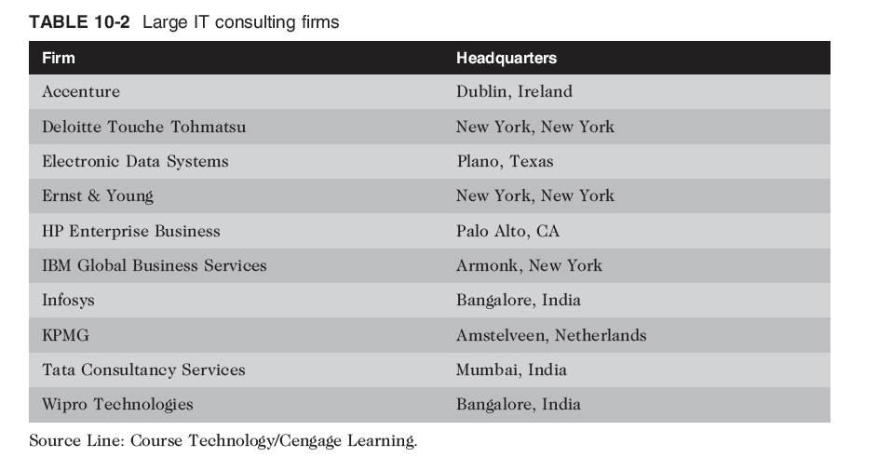
Ethics in Information Technology, Fourth Edition

Slide 10
Contingent Workers (cont’d.)
Employee leasing(rent)
  Arrangement in which a firm (called subscribing firm) transfers its employees to another firm (called leasing firm) which specializes in human resource management, payroll accounting, and risk administration. The subscribing firm leases its employees back as employees of the leasing firm and usually pays more for their services than their salaries at the time of transfer. This way the payroll and associated expenses and taxes of the leased employees become the leasing firm's liabilities.
Ethics in Information Technology, Fourth Edition

Slide 11
Contingent Workers (cont’d.)
Advantages of using contingent workers
  Can continually adjust the number of contingent workers to stay consistent with its business needs
  Does not customarily incur training costs
Ethics in Information Technology, Fourth Edition

Slide 12
Contingent Workers (cont’d.)
Disadvantages of using contingent workers
  Workers may lack a strong relationship with the firm
    Low commitment to the company and its projects
  Workers gain valuable practical experience working within a company’s structure and culture
    Lost when workers depart at the project’s completion
Ethics in Information Technology, Fourth Edition

Slide 13
Contingent Workers (cont’d.)
When deciding to use contingent workers:
  Recognize the trade-off between:
    Completing a single project quickly and cheaply
    Developing the skill of the exiting employee in the organization
  When staffing is truly temporary:
    Use of contingent workers is a good approach
Ethics in Information Technology, Fourth Edition

Slide 14
H-1B Workers
Temporary work visa
  U.S. Citizenship and Immigration Services (USCIS)
  For people who work in specialty occupations
H-1B workers
  Meet critical business needs
  Have essential technical skills and knowledge.
  Employers must pay H-1B workers the prevailing wage for the work being performed
Ethics in Information Technology, Fourth Edition

Slide 15
H-1B Workers (cont’d.)
Maximum continuous period of six years
  After six years, the foreign worker must remain outside the United States for one year before another H-1B petition can be approved
Continued use of H-1B workers
  Symptom of a larger, more fundamental problem
  U.S. not developing sufficient IT employees
Ethics in Information Technology, Fourth Edition

Slide 16
H-1B Workers (cont’d.)
English as a second language
  Workers who are not fluent in English:
    May find it difficult and uncomfortable to participate
    May create their own cliques(“groups)
    May stop trying to acclimate(indulging into environment)
    Can hurt a project team’s morale and lead to division
Managers and coworkers should:
  Strive to help improve H-1B workers’ English skills and cultural understanding
  Be sensitive to workers’ heritage and needs
Ethics in Information Technology, Fourth Edition

Slide 17
H-1B Workers (cont’d.)
H-1B application process
  Employer making job offer must also offer sponsorship
  Application has two stages
    Labor Condition Attestation (LCA)
    H-1B visa application
  If H-1B are more than 15% percent of company’s workforce:
    Must prove that it first tried to find U.S. workers
    Must prove not hiring H-1B after laying off similar U.S. worker
Ethics in Information Technology, Fourth Edition

Slide 18
Process
The company files an LCA with the department of labor(DOL),stating the job title, the geographic area as well as the salary.
After LCA certification, the employer may then apply to the USCIS for H-1B visa,identifying who will fill the position and stating person’s skill and qualification.
Ethics in Information Technology, Fourth Edition

Slide 19
A candidate cannot be hired until USCIS has processed the application , which can take several days or months.
Ethics in Information Technology, Fourth Edition

Slide 20
H-1B Workers (cont’d.)
  At end of the six-year visa term:
    If no green card, firm loses worker
    Suddenly unemployed worker must return home
    Latest rules for H-1B workers
    https://www.gadgetsnow.com/slideshows/new-h-1b-visa-rules-announced-6-biggest-changes/Increases-the-burden-of-paper-work/photolist/63054480.cms
Ethics in Information Technology, Fourth Edition

Slide 21
B - 1 Visa Controversy
B-1 visitor visa for people who wish to enter U.S. temporarily:
  For pleasure or medical treatment
  To travel for short periods of time to consult with business associates; attend convention or conference; negotiate a contract; or install or maintain machinery
B-1 visa faster, easier, and cheaper to obtain
Ethics in Information Technology, Fourth Edition

Slide 22
Outsourcing
Outsourcing
  Approach to meeting staffing needs
  Long-term business arrangement
    Company contracts with an outside organization that has expertise in providing a specific function
  Lower costs
  Obtain strategic flexibility
  Keep staff focused on core competencies
Ethics in Information Technology, Fourth Edition

Slide 23
Offshore Outsourcing
Variation of outsourcing
  Services provided by an organization whose employees are in a foreign country
  Work done for a company by people in another country that it typically done at a much cheaper cost. Outside of costs, offshore outsourcing may be used to complete tasks that the company may not be equipped to handle in-house. Call centers are a popular service that is often outsourced to other countries.
Companies reduce labor costs
Common to use offshore outsourcing for major programming projects
Ethics in Information Technology, Fourth Edition

Slide 24
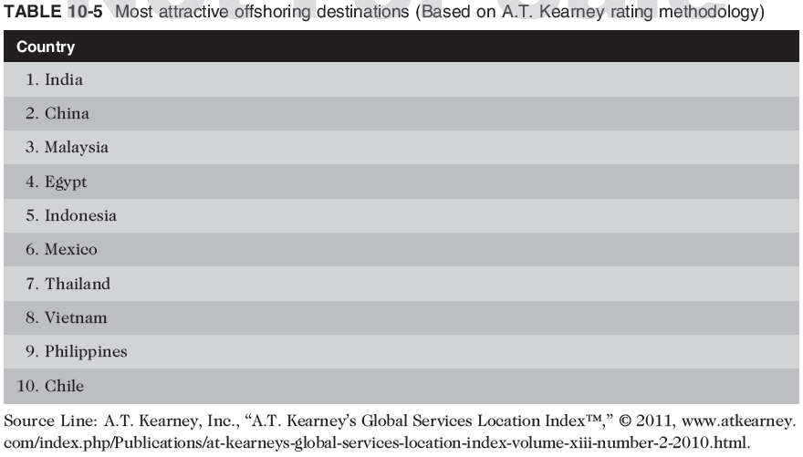
Offshore Outsourcing (cont’d.)
Ethics in Information Technology, Fourth Edition

Slide 25
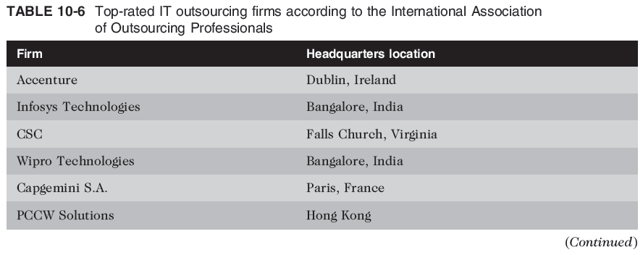
Offshore Outsourcing (cont’d.)
Ethics in Information Technology, Fourth Edition

Slide 26
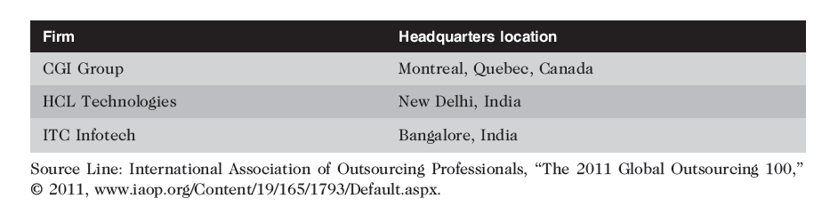
Offshore Outsourcing (cont’d.)
Ethics in Information Technology, Fourth Edition

Slide 27
Offshore Outsourcing (cont’d.)
Pros and cons of offshore outsourcing
  Low wages
    Why pay US It worker a six fig salary , when they can use offshore outsourcing to hire three Indian bases workers for same cost.
  Can also result in new expenses
    Additional time to select an offshore vendor
    Additional costs for travel and communications
  Difficulty of communications over long distances and differences in culture and language
  https://www.talkdesk.com/blog/the-pros-and-cons-of-call-center-offshore-outsourcing-2/
Ethics in Information Technology, Fourth Edition

Slide 28
Offshore Outsourcing (cont’d.)
Strategies for successful offshore outsourcing
  Expertise in technologies involved in the project
  Project manager speaks native language of employer
  Large staff available
  State-of-the-art telecommunications setup
  High-quality on-site managers and supervisors
Ethics in Information Technology, Fourth Edition

Slide 29
Whistle-Blowing
Effort to attract public attention to a negligent, illegal, unethical, abusive, or dangerous act by a company
Whistle-blower
  Usually has personal or special knowledge
  Risks own career
  Might even affect lives of friends and family
  Must choose between protecting society and remaining silent
Ethics in Information Technology, Fourth Edition

Slide 30
Whistle-Blowing (cont’d.)
False Claims Act (“Lincoln Law”)
  Enacted during the Civil War
  Enticed whistle-blowers to come forward
  Offered a share of the money recovered
Qui tam provision allows private citizen to file in name of government(example a physician may charge the government for medical services that a nurse actually performed)
Violators are liable for three times the dollar amount the government is defrauded
Provides strong whistle-blower protection
Ethics in Information Technology, Fourth Edition

Slide 31
Whistle-Blowing (cont’d.)
Whistle-blower protection for private-sector workers
  Many states, not all, have laws that prevent workers from being fired because of an employee’s participation in “protected” activities
Whistle-blowers can file claims against their employers for retaliatory(wrong) termination
Whistle-blowers are entitled to jury trials
If successful at trial, can receive punitive damage awards
Ethics in Information Technology, Fourth Edition

Slide 32
Whistle-Blowing (cont’d.)
Dealing with a whistle-blowing situation
  Assess the seriousness of the situation
  Begin documentation
  Attempt to address the situation internally
  Consider escalating the situation within the company
  Assess implications of becoming a whistle-blower
  Use experienced resources to develop action plan
  Execute the action plan
  Live with the consequences
Ethics in Information Technology, Fourth Edition

Slide 33
Green Computing
To manufacture truly “green” products, companies must:
  Produce product that requires less electricity
  Reduce the amount of hazardous materials used
  Increase amount of reusable or recyclable materials
  Help consumers dispose of their products in an environmentally safe manner at the end of the product’s useful life
Ethics in Information Technology, Fourth Edition

Slide 34
Green Computing (cont’d.)
Personal computers and cell phones contain thousands of components composed of many different materials
  Some harmful to humans and environment
  Workers along the entire supply chain at risk
  Users can also be exposed to these materials
  https://www.brighthub.com/environment/green-computing/articles/71389.aspx
  https://www.vpit.ualberta.ca/green/?ref=things
Ethics in Information Technology, Fourth Edition

Slide 35
Green Computing (cont’d.)
EPEAT (Electronic Product Environmental Assessment Tool)
  Enables purchasers to evaluate, compare, and select electronic products
    It assesses various lifecycle environmental aspects of a device and ranks products as Gold, Silver or Bronze based on a set of environmental performance criteria)
    Products are rated Bronze, Silver or Gold depending upon the number of criteria the devices meet. Bronze-rated products meet all the required criteria in each EPEAT product category. Silver-rated products meet all the required criteria plus at least 50% of the optional criteria. Gold-rated products meet all the required criteria plus at least 75% of the optional criteria
    https://www.epeat.net/resources/criteria-2/

Slide 36
ICT Industry Code of Conduct
Electronic Industry Citizenship Coalition (EICC)
  Promotes common code of conduct for ICT industry
  Focuses on the areas of:
    Worker safety and fairness
    Environmental responsibility
    Business efficiency
Code of conduct defines performance, compliance, auditing, and reporting guidelines across five areas of social responsibility
Ethics in Information Technology, Fourth Edition

Slide 37
ICT Industry Code of Conduct (cont’d.)
Guiding principles of social responsibility
  Labor
    Must uphold the human rights of workers
  Health and safety
    Must provide safe and healthy work environment
  Environment
    Adverse effects minimized
  Management system
    Ensures compliance with code
  Ethics
    Must uphold the highest standards of ethics
Ethics in Information Technology, Fourth Edition

Slide 38
Summary
Contingent workforce includes:
  Independent contractors
  Temporary workers through employment agencies
  On-call or day laborers
  On-site workers provided by contract firms
Outsourcing
  Long-term business arrangement
  Contract for services with outside organization
  Expertise in providing a specific function
Ethics in Information Technology, Fourth Edition

Slide 39
Summary (cont’d.)
Whistle-blowing
  Effort to attract public attention to negligent, illegal, unethical, abusive, or dangerous acts by company
  Whistle-blowing process
    Assess the seriousness of the situation
    Begin documentation
    Attempt to address the situation internally
    Consider escalating the situation within the company
    Assess the implications of becoming a whistle-blower
    Use experienced resources to develop an action plan
    Execute the action plan
    Live with the consequences
Ethics in Information Technology, Fourth Edition

Slide 40
Summary (cont’d.)
Green computers
  Use less electricity
  Include fewer hazardous materials
  Contain reusable or recyclable material
Manufacturers must help consumers:
  Dispose of products in an environmentally safe manner at the end of the product’s useful life
EPEAT (Electronic Product Assessment Tool)
  Purchasers can evaluate, compare, and select
  Based on 51 environmental criteria
Ethics in Information Technology, Fourth Edition

